Slide 1

Basic Principles of Molecular Dynamics (MD) theory
Dr Karina Kubiak - Ossowska
High Performance Computing Support Team
Department of Physics
e-mail: karina.kubiak@strath.ac.uk

Slide 2


MD Definition
Molecular Dynamics is a computer simulation of physical movements of atoms and molecules. The trajectories of molecules and atoms are determined by numerically solving the classical equations of motion (Newton’s equations) for a system of interacting particles, where forces between the particles and potential energy are defined by molecular mechanics force fields.
This was first accomplished in 1957 and 1959 for a system of hard spheres by Adler. Now is applied mostly in materials science and modeling of biomolecules.

Slide 3
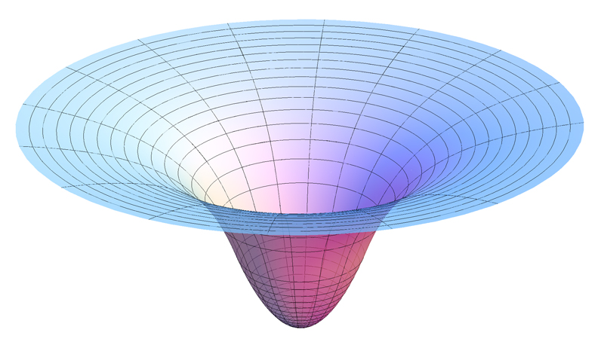
Definitions
Potential energy is associated with a set of forces that act on a body in a way that depends only on the body position in space. The set of forces can be considered as a force field. In other words potential energy is the energy of the object or the system due to its position. The SI unit for energy is the joule (J)
Force field is an area where the forces acts. It can be for example a gavitational force field around a uniform spherical body (picture)

Slide 4

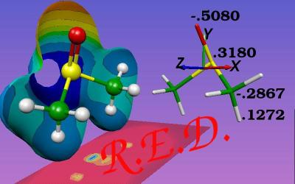
Force field

Slide 5
Definitions
Molecular mechanics (MM) uses classical mechanics to model molecular systems. The potential energy of all systems in molecular mechanics is calculated using force fields. MM can be used to study small and large molecules with thousands or millions of atoms.
Basic principles of MM:
Each atom is simulated as a single particle
Each particle has an radius (typically the van der Waals radius), polarizability and constant net charge
Bonded interactions are treated as “springs” with an equilibrium distance equal to the experimental or calculated bond

Slide 6
Molecular Mechanics
Molecular mechanics (MM) in MD is used for energy minimization. The force field is used as an optimization criterion and the local minimum is searched by an appropriate algorithm (conjugate gradient, steepest descent). The main aim is to find the lowest (one of the lowest) energy conformation of a molecule.
MM can be used for biomolecule optimization, design of (drug, small molecules) binding sities, protein folding kinetics …

Slide 7
Molecular Dynamics
MD trajectory is a series of atoms positions (snapshots) in time.
MD gives an access to events which cannot be observed experimentally. We can see the molecule! MD predict the protein dynamics, structure changes upon binding of ions and small molecules (like drugs), UV irradiation or other structure alteration (mutations). It is possible to monitor protein adsorption, protein aggregation, folding and unfolding, structure changes upon changing the environment.
Theoretical methods are typically cheaper and faster than the experimental ones.

Slide 8

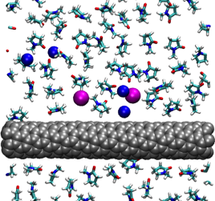
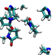
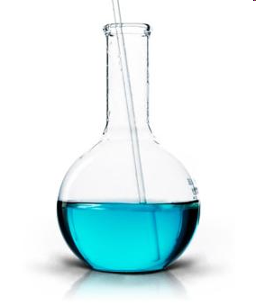
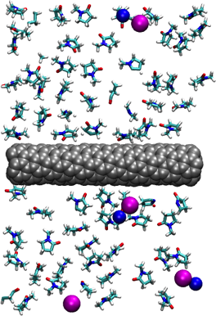
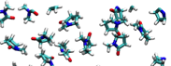
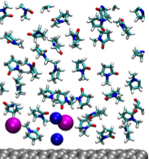
Molecular Dynamics
MD is a computational microscope. Understanding how things work on a detailed molecular level ranging from electronic structures to long-time phase behavior of molecules
If one understands how things work,
one can manipulate them!

Slide 9
MD limitations
We would like to simulate bigger and bigger systems for the longer timescales relevant to the timescales of natural processes. But ….
The bigger system – the longer computation time
The longer simulation timescale – the longer computation time.
Explicit water – the longer computation time
MD simulations are computationally costly, they require hundreds or even millions of CPU years…..
There are methods to reduce the computational cost (timestep, SHAKE algorithm, cut-offs, PME, implicit solvent and … High Performance Computers (HPCs)

Slide 10

Molecular Dynamics
It is relatively cheap and fast method to verify experimental predictions and to propose hypothesis to be checked in the experiment. Requires a powerful computers like ARCHIE-WeSt.

Slide 11
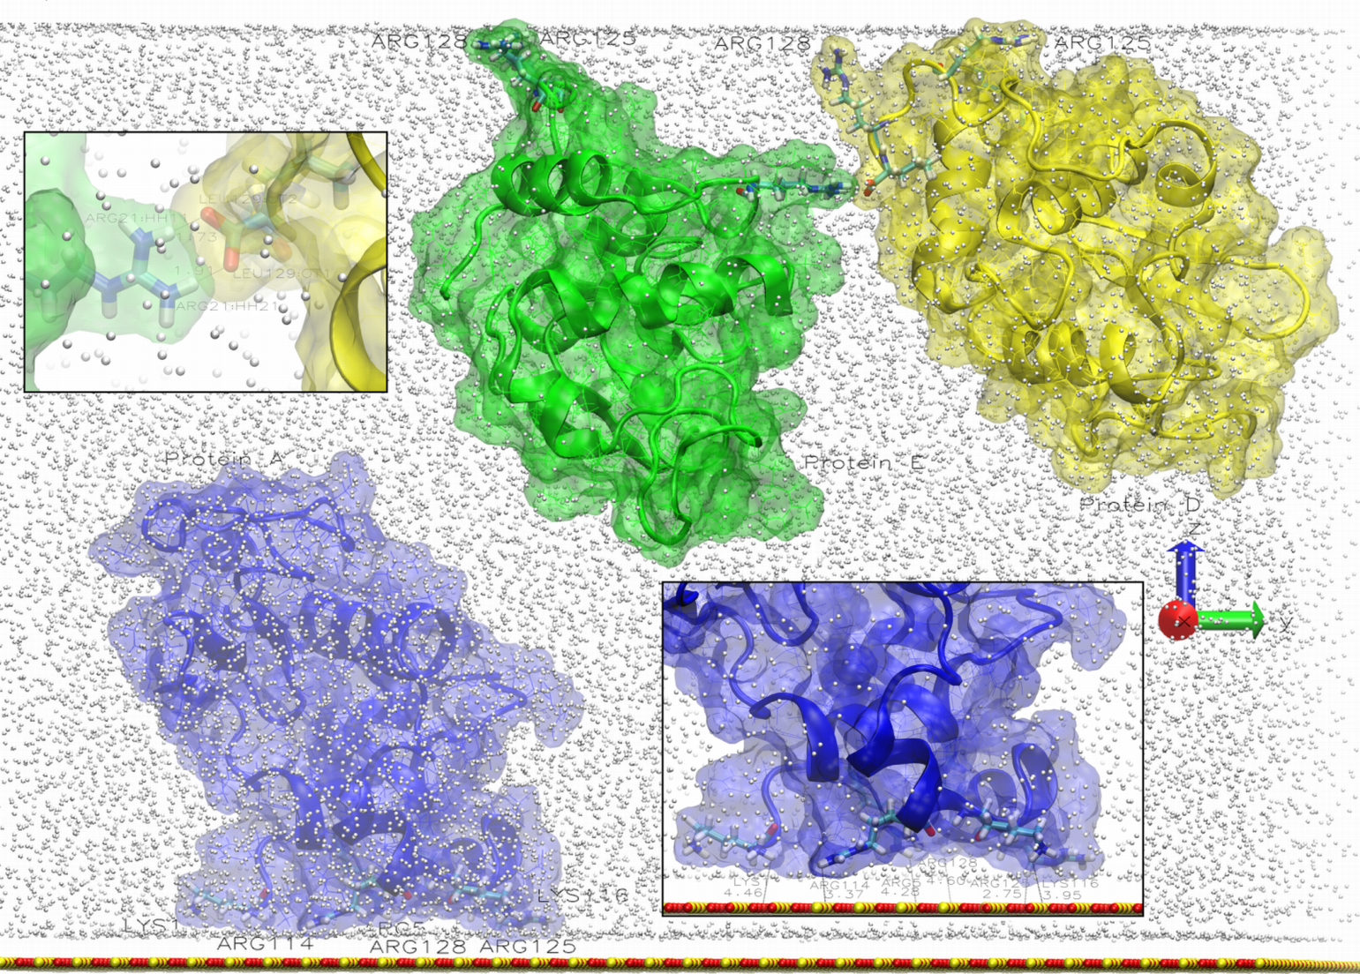
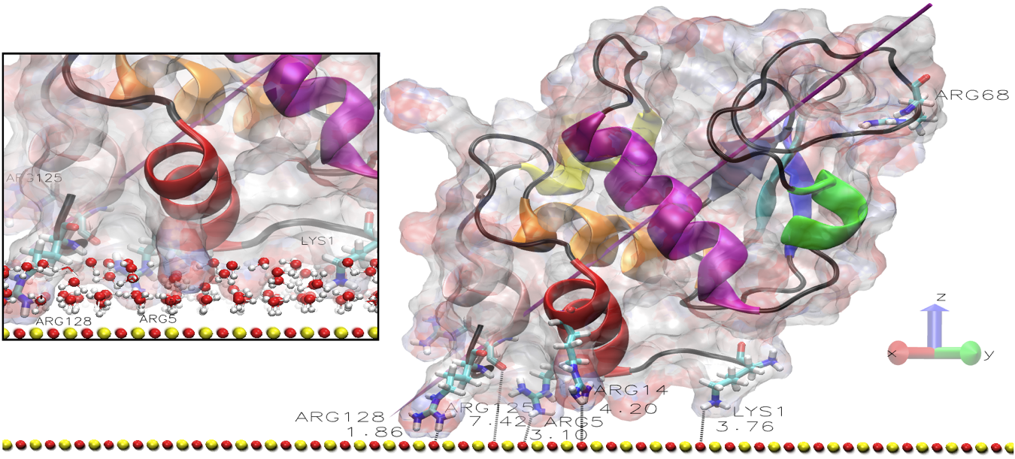
Sample Application:
Protein adsorption
Thanks to the simulations we can see how the protein aggregates on atomistic level, describe the adsorption and the diffusion mechanism.
Notes:
bla

Slide 12
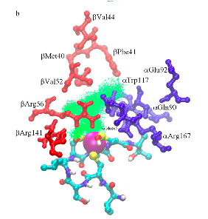
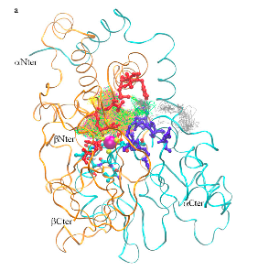
Sample application: enzymatic activity
Using MD approach we can study enzymes activity and have an insight into detailed catalytic activity mechanism. NHase is industrial, light-active enzyme catalyzing nitrile (toxic) hydratation to amides (very useful).
Notes:
Artificial life

Slide 13
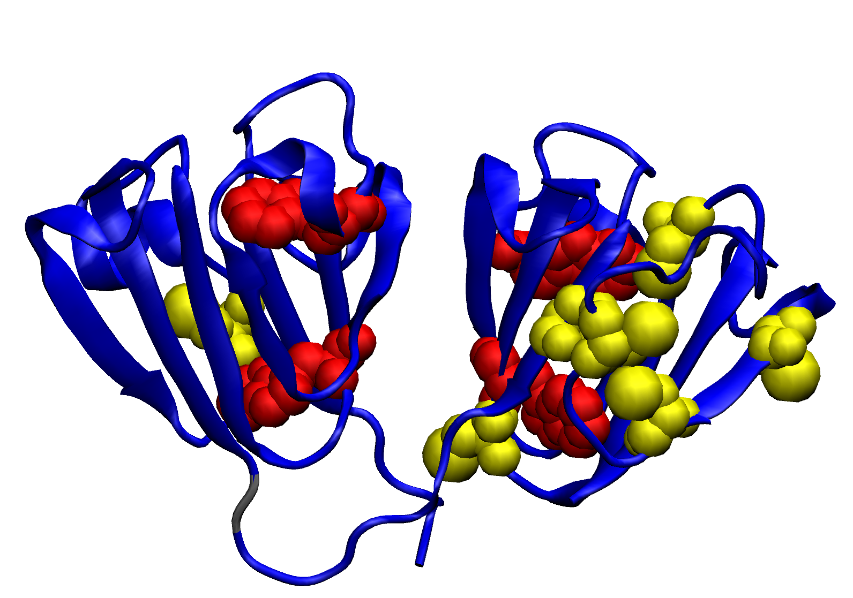
Sample application:
UV alterations
Gamma-crystalins from human eye lens are responsible for lens transparency. Upon UV irradiation the lens becomes opaque due
to crystallins’ aggregation. The main reason for that are tryptophan alterations (dyes creation) what influences on protein structure and results in aggregation.
Notes:
Artificial life

Slide 14
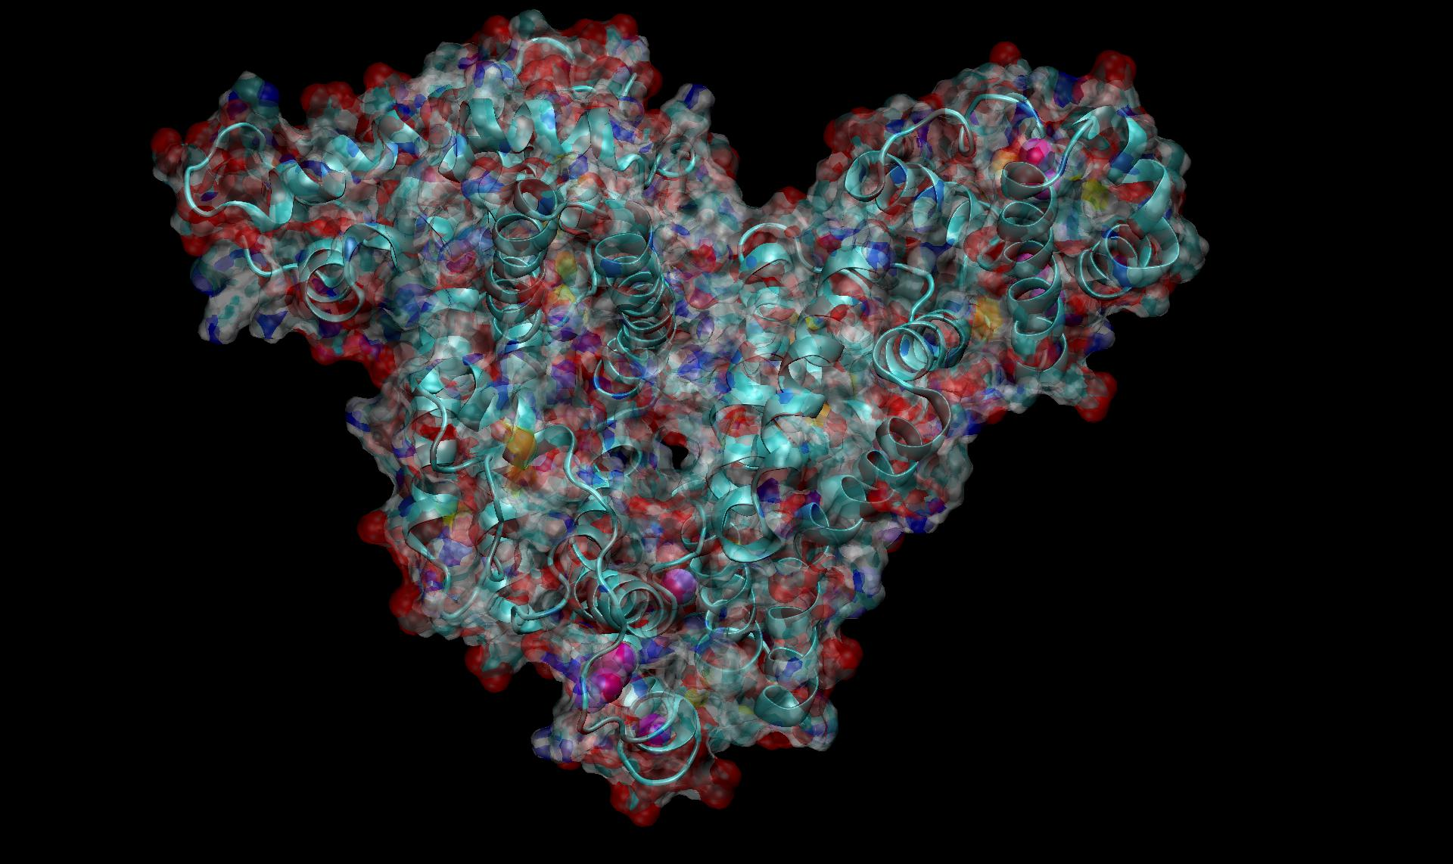
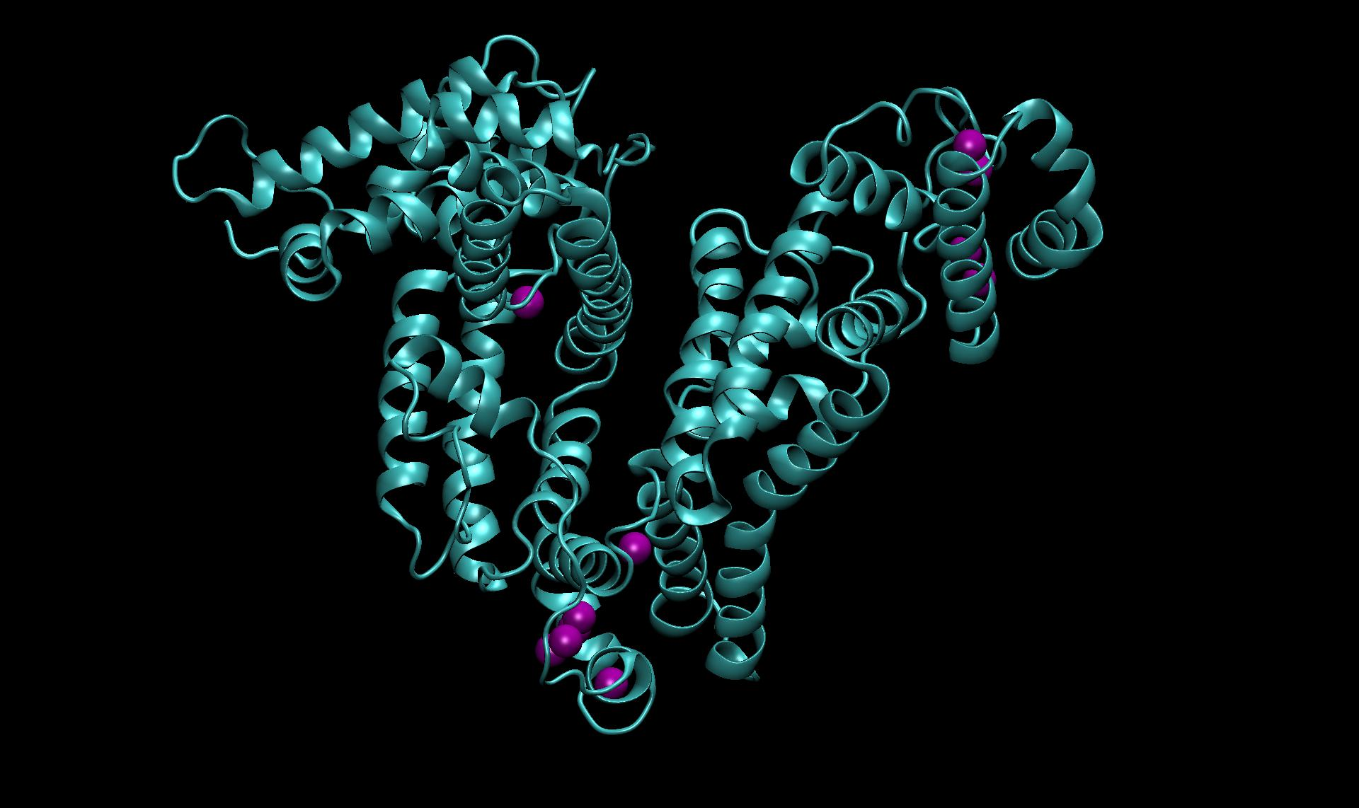
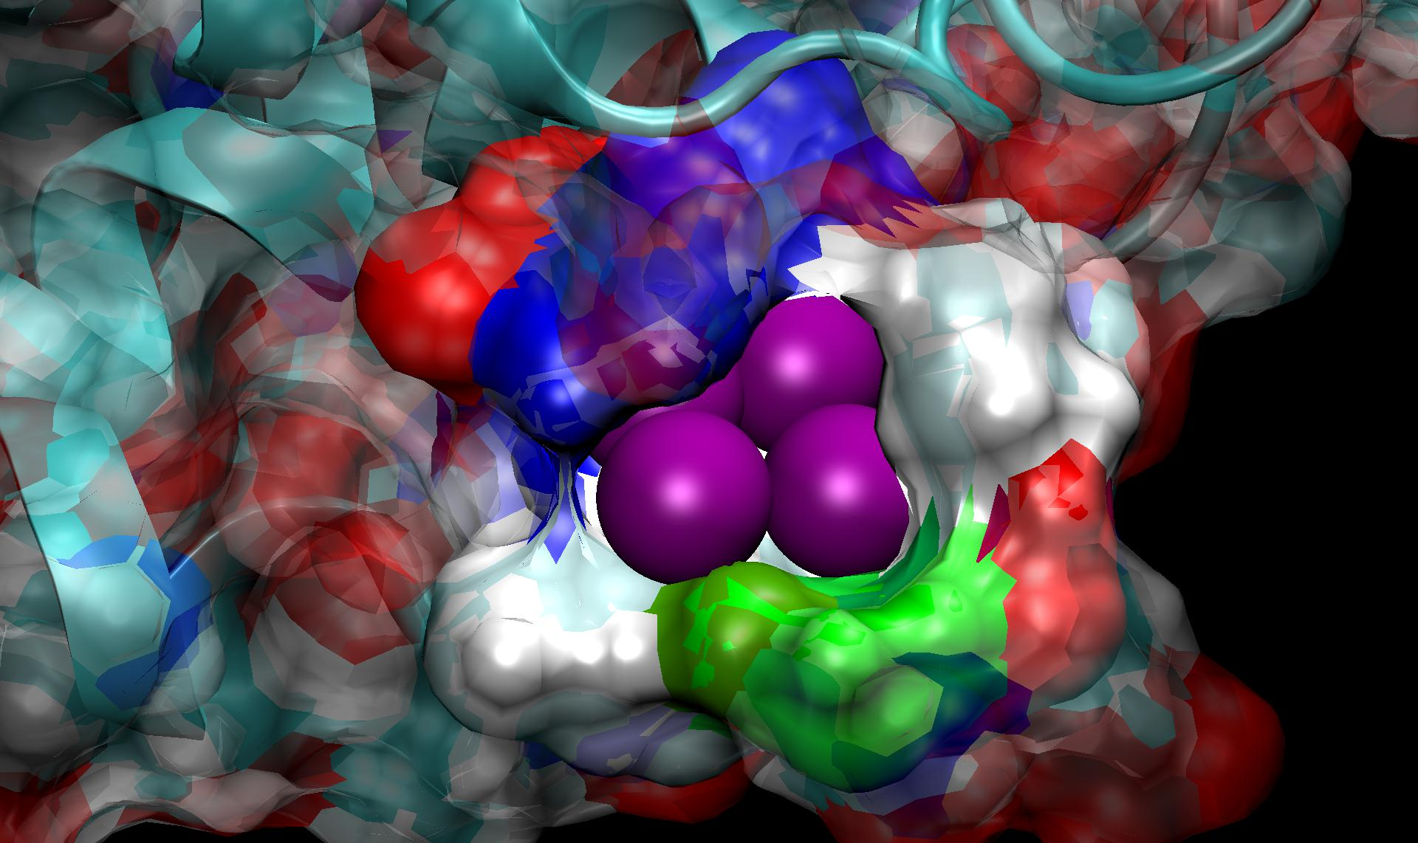
Sample application:
BSA gold binding
Bovine Serum Albumin (BSA) can bind gold ions and serve as a matrix for gold nanoparticles creation.
Notes:
Artificial life

Slide 15
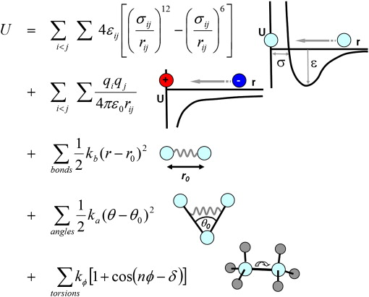

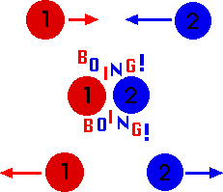
Approximations
Bonding interactions are modeled as springs (harmonic oscillators)
All atoms are treated as a hard spheres (balls)
All collisions are perfectly elastic (the total kinetic energy and momentum is conserved, no changes in the particle shape) as in noble gas atoms
Atomic charges are not changed during the trajectory
Bonds cannot be created (or destroyed) during the simulation

Slide 16
To run MD we have:
Build the molecule – find the (x,y,z) position of all atoms
Create (or apply existing) the force field (chose the software package)
Find the optimal structure (energy minimization)
Solve the Newton’s equations of motions of all atoms in the force field at each time moment (timestep) -> the trajectory
Analyze the trajectory obtained, make or verify hypothesis and … write the paper ☺

Slide 17
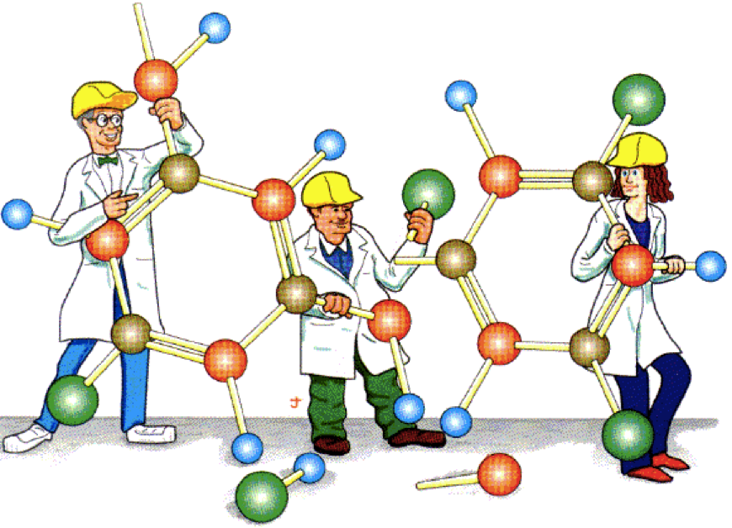

Slide 18
Build the protein?
Building the protein is not very good idea, there is too many atoms with certain (x,y,z) positions. The 3D protein structure is crucial for its activity…
How to put the protein into the computer?
Protein Data Bank (pdb). Visit the page http://www.rcsb.org/pdb/home/home.do and download the structure!

Slide 19
Protein in the computer
Protein structures are solved by:
X-ray diffraction. Experimentalist has to make the protein crystal first (difficult), H-hydrogen atoms are not visible within this method (so we have to add them)
NMR. Works well only for small molecules, the entry includes several possible conformations – we have to chose one of them
Sometimes there are numerous entries for the same protein. How to chose the best structure? Check the deposition date, the resolution, experimental conditions, presence of any additives, if there are missing atoms or residues. It is easy to add the missing atoms, adding missing residues is more complicated.

Slide 20

Force field
Protein atoms exist and move on the curved, multi-dimensional energy landscape which we want to reproduce.

Slide 21
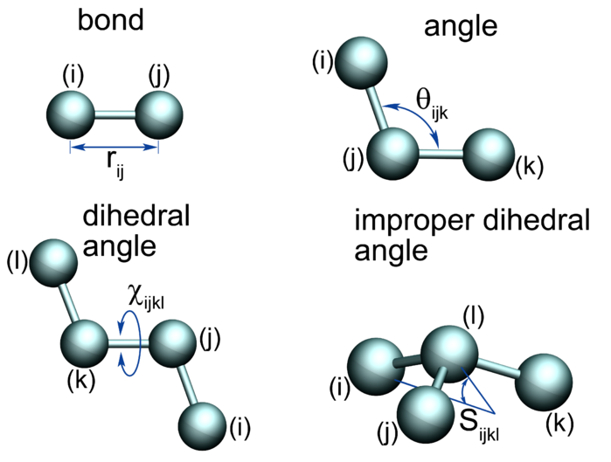
Force field - bonding interactions
Simple harmonic oscillator approximation (neither driven nor damped)
b₀

Slide 22
Force field – non bonding interactions

Slide 23
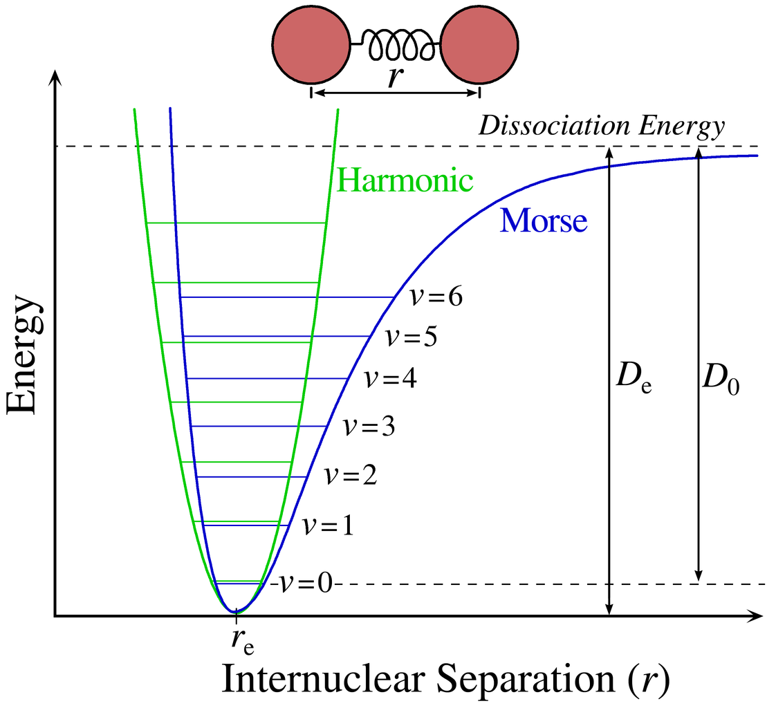
Morse potential
It explicitly includes the effect of bond breaking. Realistic but difficult to model.
De – the well depth
α - the well width
k_{e} - the force constant at the minimum of the well

Slide 24
Energy minimization
Energy minimization methods are used to compute the equilibrium configuration of molecules. Stable states of molecules correspond to global and local minima on their potential energy surface. Starting from non-equilibrium geometry the mathematical procedure of optimization moves atoms to find the lowest energy configuration.
Energy minimization does not include the temperature. From physical point of view the final state of the system corresponds to the configuration of atoms in zero temperature.
Potential energy surface – multidimensional surface (hypersurface) with atomic positions as variables. During the minimization procedure we change atoms coordinates to find the global (ideally) minima.

Slide 25
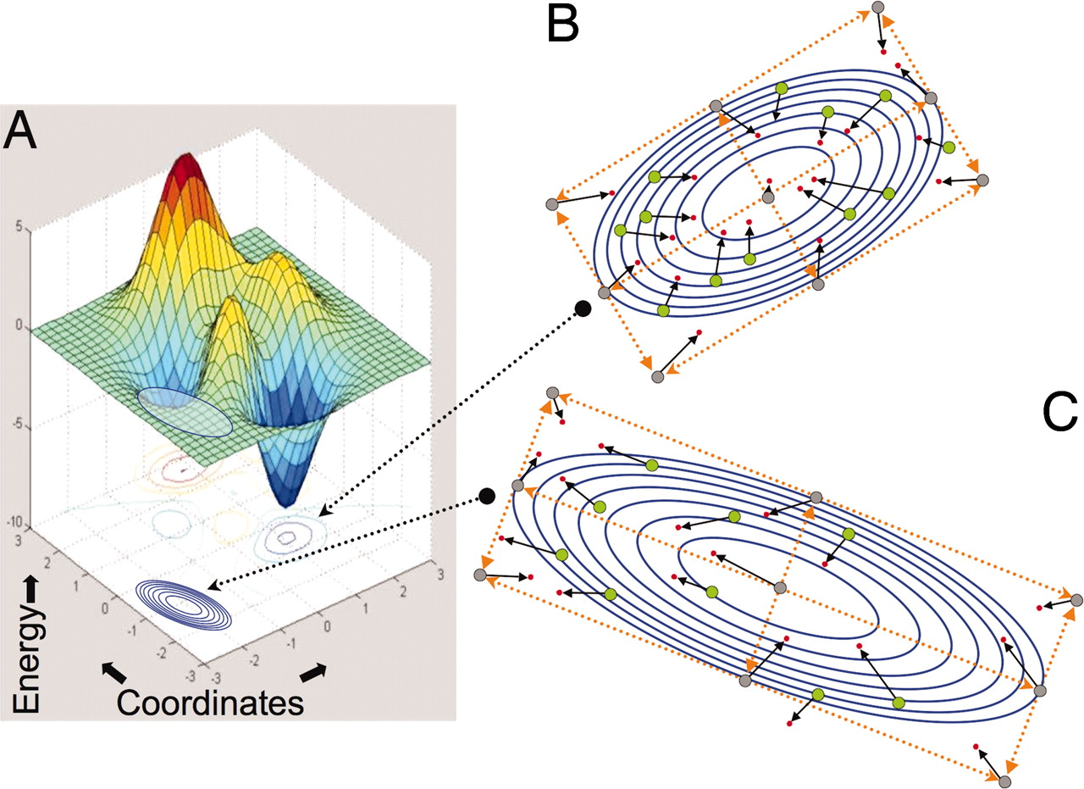
Energy surface

Slide 26
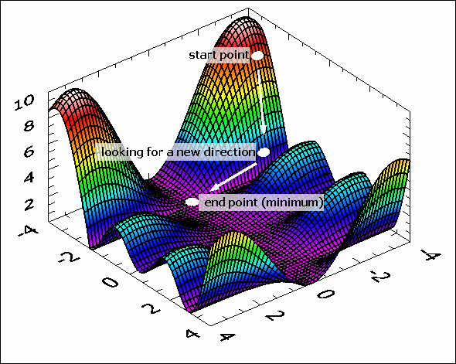
Energy minimization
Gradient-based algorithms (the most popular: simple gradient, conjugate gradient.
The steepest descent method represents other approach.
Conjugate gradient search

Slide 27
Newton’s equations
The force field defines the potential energy where
is a set of separate atom vectors
and N is a number of atoms in the system.
We know that the force acting on atom i is:
and simultaneously from Newton’s second law:
and we want to find (solve the equation on motion) for atoms i=1, 2,...,N

Slide 28
The Verlet algorithm
The Verlet algorithm is a numerical method used to integrate Newton’s equations of motion. The basic idea is to write two third-order Taylor expansions for the atom i positions one forward and one backward in time (Δt is a time step):
Adding the two expressions gives the basic form of the Verlet algorithm:

Slide 29
The Verlet algorithm
☺
The truncation error is of order of
The acceleration can be obtained from:
and as:
In this algorithm the velocities are not directly generated. While they are not needed for evolution, their knowledge is necessary to compute the kinetic energy K. The total energy E=K+U should be conserved during the trajectory.

Slide 30
The Verlet algorithm
The velocity can be calculated from
and used to calculate the kinetic energy in the time moment t:
Nevertheless the truncation error for velocity calculation is of order rather than
We would like to calculate it more precisely ➔ The velocity Verlet algorithm
☹

Slide 31
The Velocity Verlet algorithm
The position of the atom is updated every step
while the velocity is updated every step:
The acceleration in the next step :
The velocity in the next step :
☺

Slide 32
The Velocity Verlet algorithm
The same order as Basic Verlet algorithm
Fast and accurate
Linear and angular momentum preserved
Time reversible
The Velocity Verlet algorithm generates a sequence of “snapshots” for the particle coordinates and velocities at all intermediate times Δt
☺

Slide 33
Calculation procedure
Chose the molecule from the Protein DataBank
Chose the force field
Minimize the potential energy (find the optimal conformation) -> calculate which will be used to calculate initial accelerations in the trajectory calculations
Calculate the trajectory in given temperature

Slide 34
Trajectory calculations
For atom i=1:
Calculate the initial acceleration from the force field
Guess the initial velocity (Gaussian distribution with a temperature dependent variance
Calculate the position at next time interval
Repeat 1-3 for atoms i=2,…,N
Calculate the force field at the next time interval
using new positions of all atoms i=1,…,N.

Slide 35
Trajectory calculations cd
For atom i=1:
Calculate the acceleration at the next time interval
Calculate the velocity at the next half- time interval
Calculate the velocity at the next time interval
Repeat for atoms i=2,…,N
Repeat 3-9
At given intervals rescale velocities to given temperature

Slide 36
Ensembles
Microcanonical ensemble (NVE) – number of atoms (N), the system volume (V) and the total energy (E) are conserved. Canonical ensemble (NVT) - number of atoms (N), the system volume (V) and the temperature (T) are conserved. Energy is exchanged with a thermostat.
Isothermal-isobaric ensemble (NPT) - number of atoms (N), the system pressure (P) and the temperature (T) are conserved. Thermostat and a barostat are needed.
Basing on positions and velocities we have to calculate statistical quantities.

Slide 37
Simulation temperature
Temperature is a statistical quantity which has to be expressed as a function of positions and momenta of all particles in the system. For a system containing large enough number of atoms the temperature can be estimated from the kinetic energy:
where N_{f} is number of degreed of freedom in the system with N particles (atoms) and K_{B} is Boltzman constant =1.38x10⁻²³
Temperature depends on time because positions and velocities depend on time

Slide 38
Thermostats
Thermostats are algorithms to re-scale the velocities of particles to control the simulation temperature.
Berendsen thermostat – the most straight forward method, not very accurate
Langevin dynamics – more advanced and more accurate method. Now commonly used in most MD packages.

Slide 39
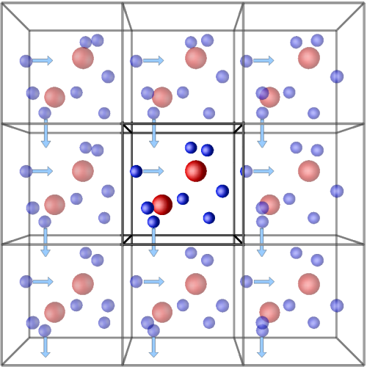
Periodic boundary conditions
The simulation box must be large enough (much larger than a molecule). Commonly used in MD, various cell geometries are available.

Slide 40
Constraint MD
Constraint algorithm is a method to constrain bodies in Newton’s equations of motion. Constraint algorithms are often used in MD to omit some part in trajectory calculations.
SHAKE algorithm satisfies bond geometry constraint in MD, is limited to mechanical systems with a tree structure (no closed loops of constraints). Other versions: Q-SHAKE, MSHAKE, and RATTLE which works well with Velocity Verlet algorithm.

Slide 41
Locally Enhanced Sampling
Locally Enhanced Sampling (LES) increases sampling and transition rates for a portion of a molecule by use of multiple non-interacting copies of the enhances atoms. These enhanced atoms experience an interaction (electrostatics, vdw, bonding) potential that is divided by the number of copies present. In this way the enhanced atoms can occupy the same space, while the multiple instances and reduces barriers increase transition rates.
Copies can’t see each other, they see the rest of the system. The rest of the system see the average potential and mass of enhanced part
Useful in studying small ligand diffusion in proteins.

Slide 42
Steered Molecular Dynamics
The basic idea behind any SMD simulation is to apply an external force to one or more atoms, which we refer to as SMD atoms. In addition, you can keep another group of atoms fixed and study the behaviour of the protein under various conditions.
SMD allows to explore biological processes on time scale accessible to MD simulations. There are two types of SMD: constant force pulling and constant velocity pulling. In constant force pulling a chosen atom is kept fixed and another one experiences a constant force in the direction defined by the vector that links the fixed and pulled atom.

Slide 43
Steered Molecular Dynamics
In constant velocity pulling the SMD atom (pulled atom) is attached to a dummy atom via a virtual spring. This dummy atom is moved with a constant velocity and then the force between them is measured:
Where:
- spring constant
- pulling velocity
-actual position of SMD atom
- initial position of SMD atom
- direction of pulling

Slide 44
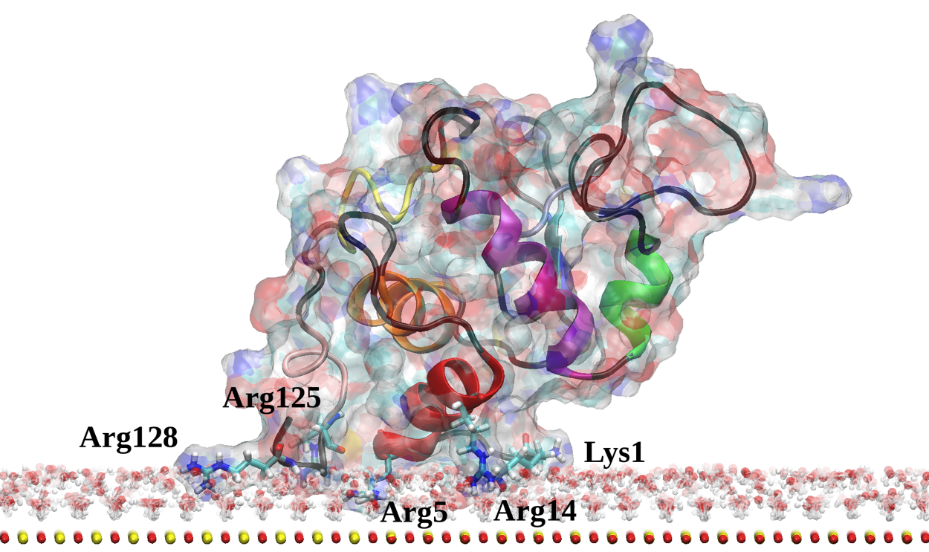
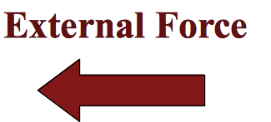
Steered Molecular Dynamics

Slide 45
Steered Molecular Dynamics
Where:
F₀ - the force at the end of transition,
k – spring constant
dF – the force change
Here:
F₀ ~ 0 N
dF ~ 575 pN
k = 278 Å/pN
dE=543pN*Å (10^{-22J}J)
dE=0.34 eV

Slide 46
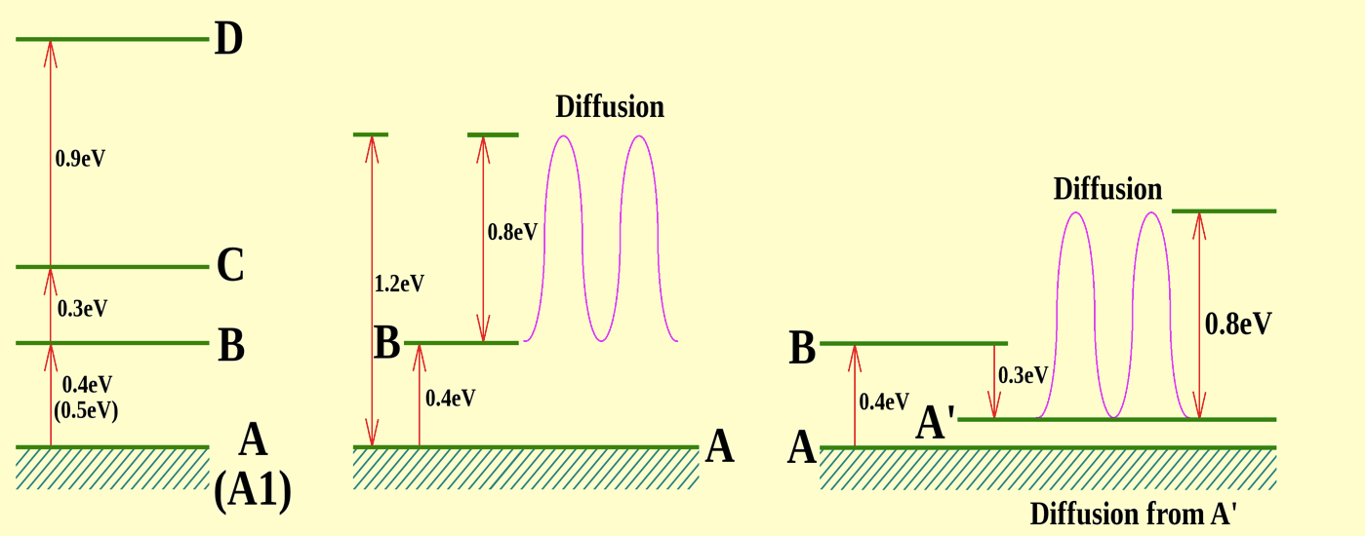
Steered Molecular Dynamics

Slide 47
Particle Mesh Ewald
Ewald summation is a method for computing the interaction energies of periodic systems, particularly electrostatic energies.
Particle Mesh Ewald (PME), since 1970s
As in normal Ewald summation, the interaction is separated into two terms: short and long-range. PME replaces the direct summation of interaction energy between point particles with two summations: a direct sum of the short-ranged potential in real space and a summation in Fourier space of the long-ranged part. Both summations converge quickly, so they may be truncated with little loss of accuracy and great improvement in required computational time. The method uses FFT which requires that the density field be evaluated on a discrete lattice in space (mesh).

Slide 48
Particle Mesh Ewald
PME method can be applied to systems with periodic symmetry. In MD a charge-neutral unit cell is created which is infinitely “tiled” to form images. It means that PBC are used. The unit cell must be big enough to avoid improper motion correlations between two faces of the cell and still small enough to be computationally feasible.
PME is an efficient full electrostatic method for use with PBC. It should not affect energy conservation, although it may affect the accuracy of the result and momentum conservation. PME is more accurate and less expensive than larger cutoffs. The particle mesh is a 3D grid created in the system over which the system charge is distributed. From this charge, potentials and forces on atoms in the system are determined.

Slide 49
Cost reduction
Cut offs
The most time-consuming part in MD calculations are calculations of non-bonding interactions: van der Waals and electrostatics interactions. They should be calculated to the infinitum, what is impossible, usually we cut this calculations in 12A distance.
Constrained MD
Usually we are not interested in calculations of the fastest bond stretching (like O-H bonds). Therefore the constrained MD is used. SHAKE and RATTLE (velocity version of SHAKE) algorithms allow to constrain the length of all bonds with hydrogen atoms involved. Water molecules are kept rigid.

Slide 50
Thank you for your attention!
Dr Karina Kubiak - Ossowska
High Performance Computing Support Team
Department of Physics
e-mail: karina.kubiak@strath.ac.uk

